Slide 1
Capstone Project
Airbnb Bookings Analysis
By
Team :- Team Denver
Team Member :- Sumit , Bhoomika Data Science Student Alma Better

Slide 2

About the Airbnb
Problem statement
Data Exploration
Data Cleaning
Host and neighborhood group
Location of neighborhood group
Price distribution across neighborhood
Popular neighborhood by review
Preferred room types
Limitation
Scope of Improvement
Conclusion
What we are discuss :-

Slide 3

1. Airbnb, Inc. based in San Francisco, California, operates an online marketplace focused on short-term homestays and experiences. The company acts as a broker and charges a commission from each booking. The company was founded in 2008 by Brian Chesky, Nathan Blecharczyk, and Joe Gebbia. Airbnb is a shortened version of its original name, AirBedandBreakfast.com. The company has been the subject of criticism for lack of regulations and enabling increases in home rents. 2. The booking information on Airbnb from 2008 till 2019

Slide 4
Problem Statement :
With help of python data visualization , libraries . We will try to solve the answer of the following questions
What can we learn about the different hosts and areas?
What can we learn from prediction’s ( prices , reviews etc. )
Which type of rooms are customer demands in most popular neighborhood, neighborhood_group
Why type of reviews are made by the most of costumer’s
Limitation in Airbnb’s data
Scope of Improvement (How we help to resolve the problem)

Slide 5
Data Exploration (variable name ):
The data and its features are given below :-
Id
It is a particular identity number of property which is given to customer(host)
Name
It gives the name of property given to customer
Host_id
It is the identity number of host who have register on airbnb
Host_name
It is the customer name who registered their property on Airbnb
Neighbourhood_group
It tell the neighborhood group present in the particular city ( ex :- NYK , San Francisco etc. )
Neighborhood
It tells the neighborhood present in neighbourhood_group in the city.

Slide 6
Data Exploration (variable name ):
Neighbourhood_group
it gives a group of area
Latitude
it gives the coordinate of listing
Longitude
it gives the coordinate of listing
Room_type
it tells the type to categorize the rooms
Price
it gives the price of rooms according to room_type
Minimum_nights
It gives the info about minimum nights required to stay in a single visit.

Slide 7
Data Exploration (variable name ):
Number_of_reviews
total count of reviews given by visitors.
Last_review
date of last review given.
Reviews_per_month
it gives rate of reviews given per month
Calculated_host_listings_count
it gives total no of listing registered under the host
Availability_365
it gives the number of days for which a host is available in a year.
.

Slide 8
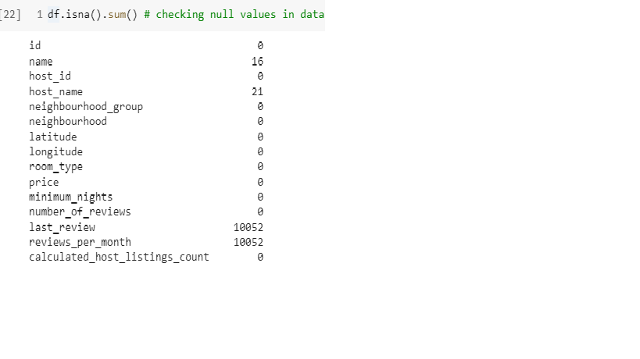
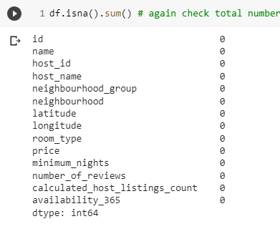
Data Cleaning :-
Fixing the null values
We have drop the unnecessary null values like numbers_of_reviews, last review ,longitude, latitude and reviews_per_month ( because it has not much meaning full values ) .
Before Cleaning the Data
After Cleaning the Data

Slide 9
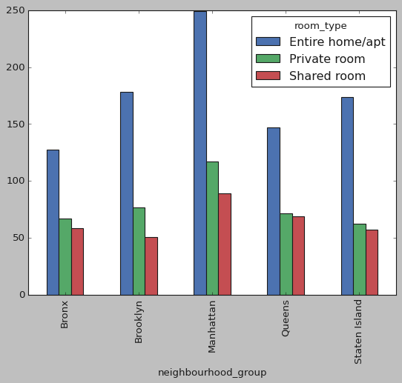
Average price of property
Manhattan has the highest price for room types with Entire home/apt ranging to nearly 249$/night, followed by Private room with 116$/night. This graph and data show the average price of manhattan.

Slide 10
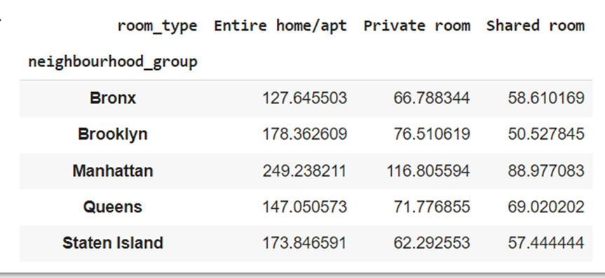
average preferred price by customers according to the location

Slide 11
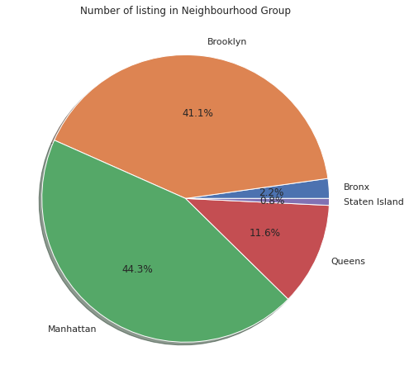
No of list made by host across Neighborhood Group
It is observed that Manhattan has highest number of listing of 21661 which is 44.3% of total listing.
Brooklyn has second highest number of listing 20104 which is 41.1% of total listing.
Queens are at third place with 5666 listing and Bronx and Staten have least number of listing.

Slide 12
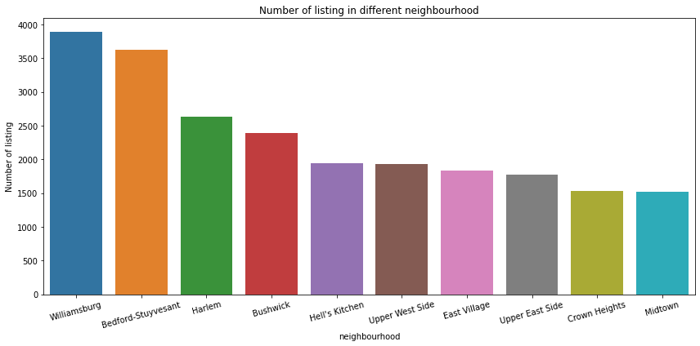
No of list made by host across Neighborhood
Most of peoples wants to live in Williamsburg and Bedford-Stuyvesant.

Slide 13
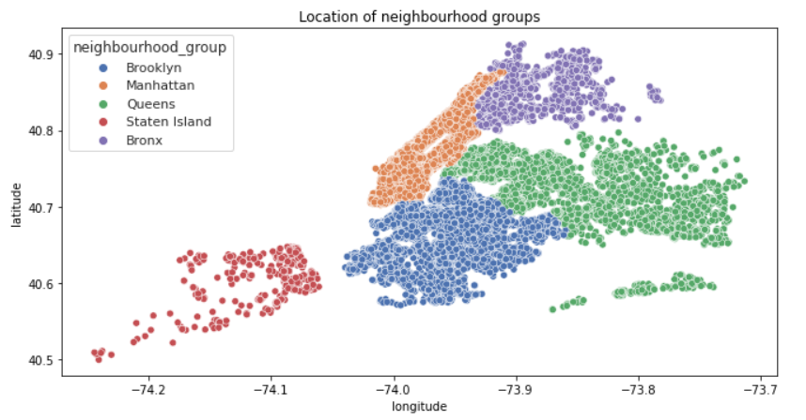
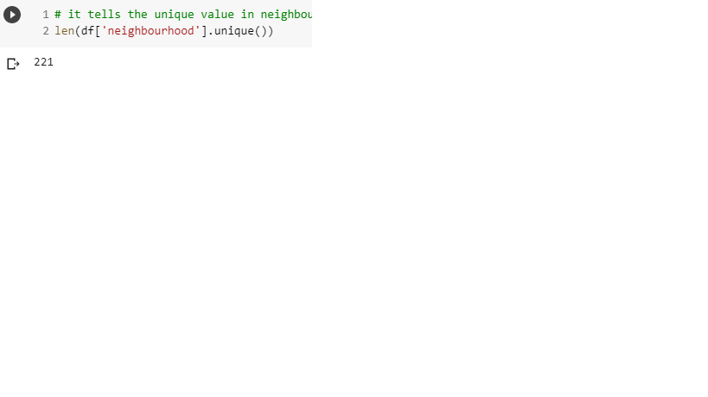
Location of Neighborhood Groups
There are 221 unique neighbourhoods falls under 5 groups

Slide 14
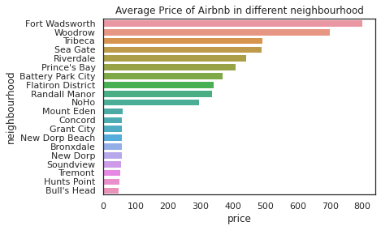
Price distribution across neighborhood
( which room type are most expensive and where it is located )
Most expensive neighborhood is fort Wadsworth followed by Woodrow then Tribeca.
Most cheapest neighborhood is hunts point followed by bull's head then Soundview.

Slide 15
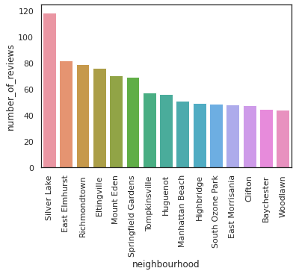
Popular neighborhood by review
( which room type are most and where it is located )
The most review neighborhood is silver lake with average reviews of 118 per month, followed by East Elmhurst with average review of 83

Slide 16
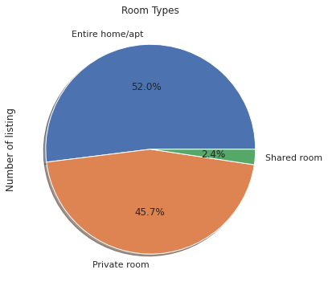
Preferred room types
( which room type people are preferred to stay longer )
The demand of entire home and private room is more high and people also choose entire home and private room.
As per the dataset 97.7% of them are entire home or private room and only 2.4% of them are share room.

Slide 17
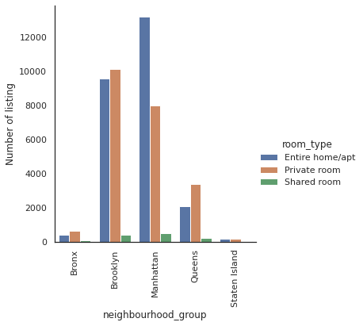
Preferred room types
( Location )
The demand of entire home is more in Manhattan followed by Brooklyn and the price is also high.
Demand of private room is more in Brooklyn followed by Manhattan.

Slide 18
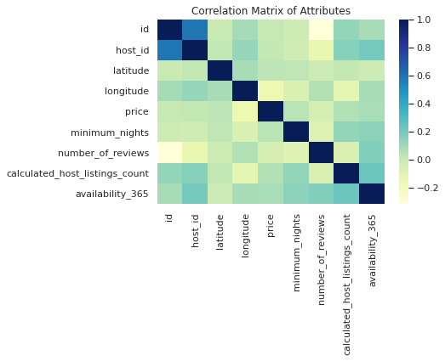
Correlation Matrix :-
All the features are less correlated with price, regression taking price as target, will be less accurate

Slide 19

Limitations
Dataset features in terms of modern world, are of very poor quality in deciding the valuation of a property
User ratings of hosts aren’t available, it would’ve been better to rank our hosts based on user satisfaction and ratings. Normally a low rated property tends to lower their price.
In order to have a better analysis regarding the quality of the properties, it would be interesting if we had an analysis of sentiments with property valuations.
The exact number of guests count also missing
Here we can see that there is minimum price $0.

Slide 20

Scope of Improvement
As dataset has less number of features to decide a property, more features can be added like bedroom, bathroom, property age (it might be one of the most important one), tax rate, distance to nearest airport, hospital, metro station or schools etc.
In presence of ratings, hosts can be classified and ranked, gives a special discount or offer to highest rated hosts following marketing strategy.
Time series analysis can be done to make decision on the rate in the tourist season.

Slide 21

Conclusion
From the entire analysis, it can be concluded that
Most visitors room is entire home/apt which is 52 percent after that private room which is 45.7 percent and least prefered room is shared room which is 2.4 percent.
Manhattan has the highest price for room types with Entire home/apt ranging to nearly 249$/night, followed by Private room with 116$/night.
Less preference places are staten island and Bronx.
Though location of property has high relation on deciding its price, but a property in popular location doesn’t mean it will stay occupied in most of the time.
Performing a regression on this dataset may result in high error rate, as the features given in this dataset, are of very poor quality in deciding the property valuation. We can see this by looking at correlation heatmap. We would need more features like bedrooms, bathroom, property age, room extra amenities, distance to nearest hospital, stores or schools. These features might have a high relation with price.

Slide 22


Thank You
Team :- Team Denver
Team Member :- Sumit , Bhoomika
Batch Name - Cohort Cairo
As part of EDA Capstone Project by

